Slide 1

FOCUS HUMANITY
Group AG
focushumanity.net
simsal.net
MATCHING THE DEMANDS
for good solutions in time and
sustainable continuation on all sides.

Slide 2
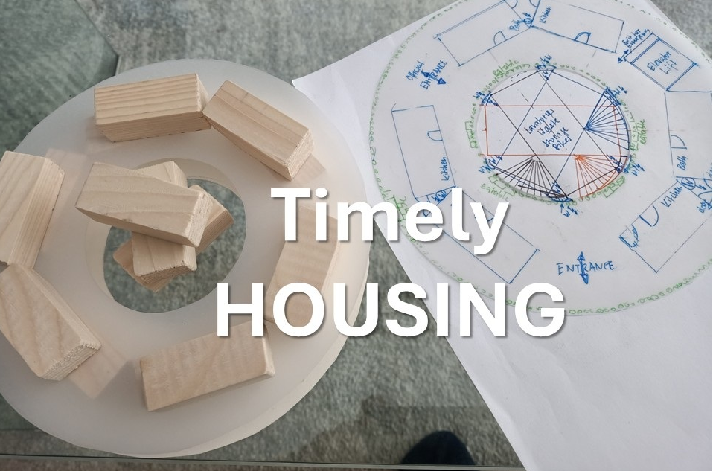
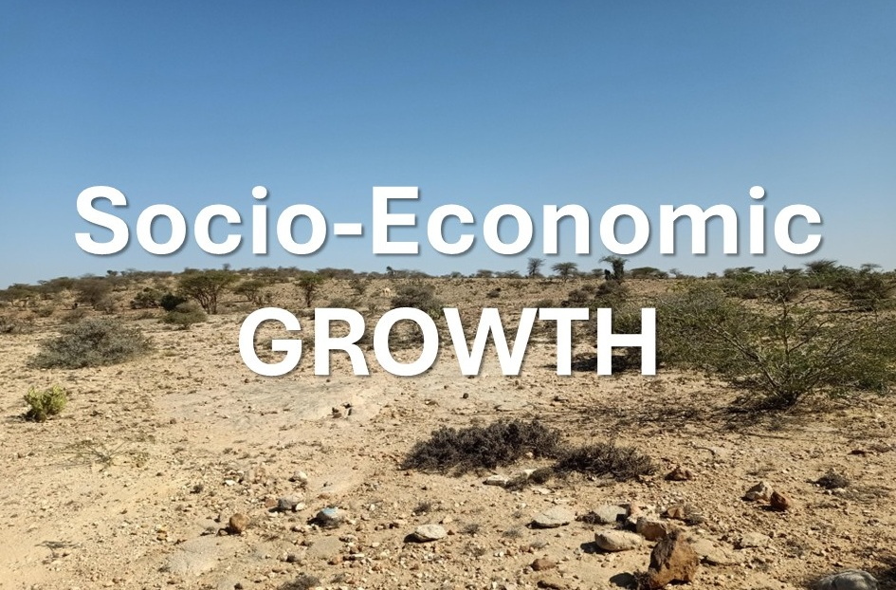

MATCHING THE DEMANDS
Gaza, Syria, Ukraine, Los Angeles
East Africa, SE-Europe
Private Equity, Family Offices, Internat. Org.

Slide 3
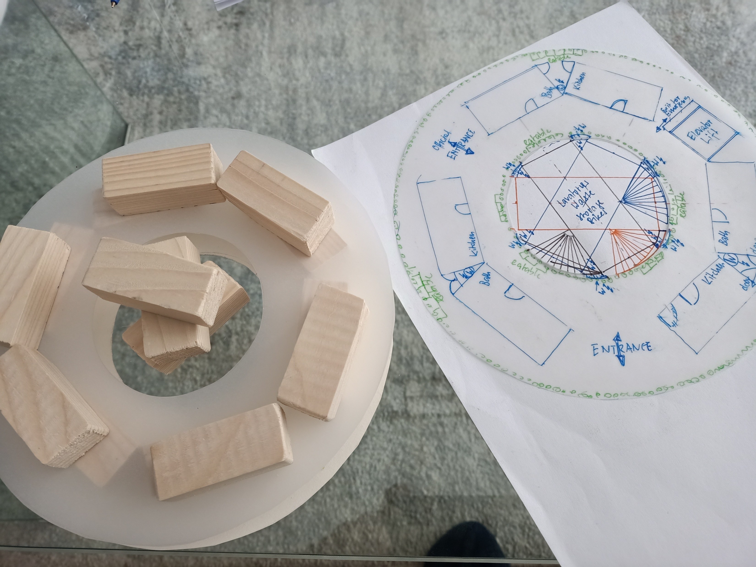
Novel Sustainable Towerhouses
Per lot: 220 tower-houses, 4000 flats for 16‘000 people
ready to move in within 200 days from now
provide comfortable living – natural air conditioning
becoming self-sufficient villages
prefabricated from industrial hemp
providing jobs to the local people
assembled and completed by the local people
carbon neutral, environment-friendly construction
adopted to the local conditions

Slide 4
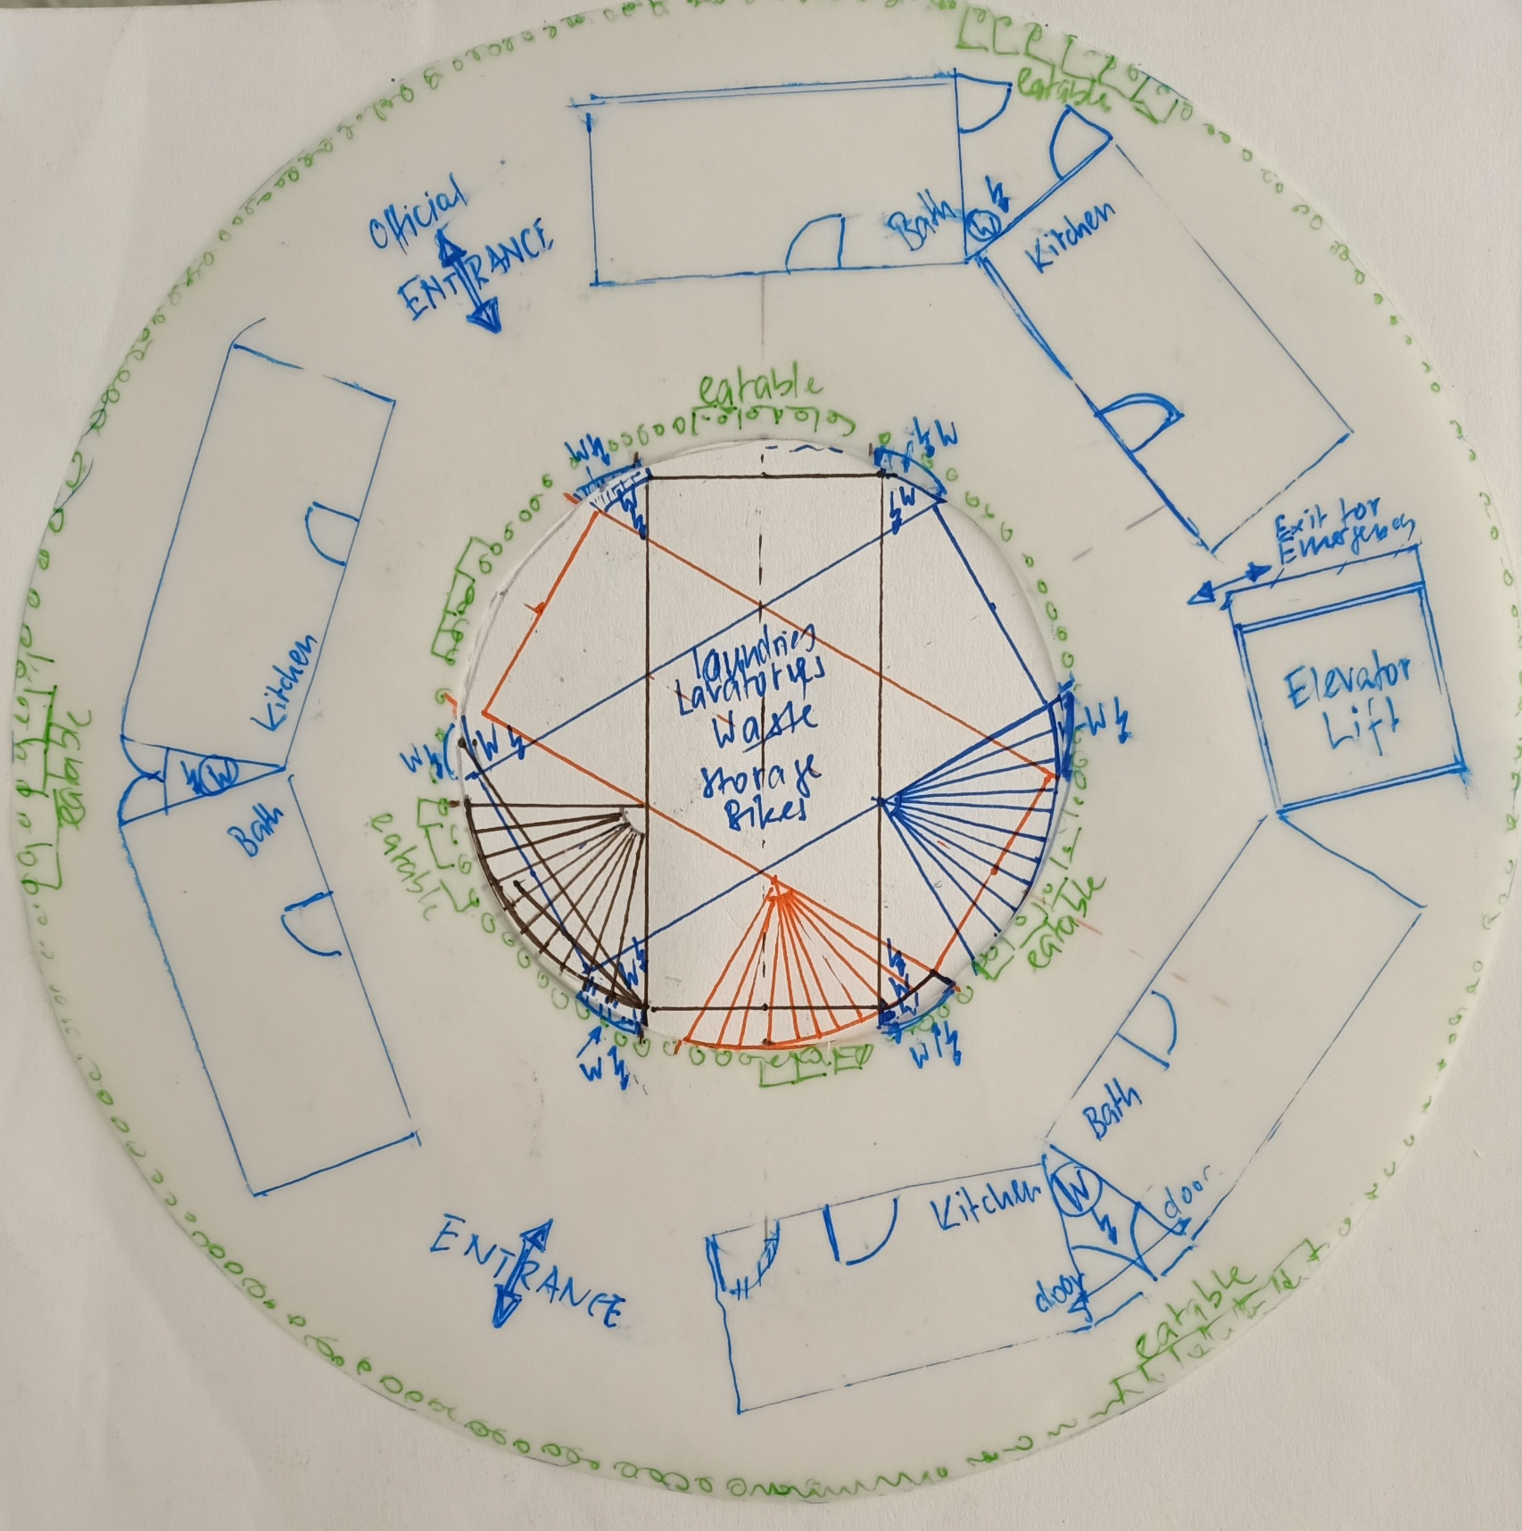
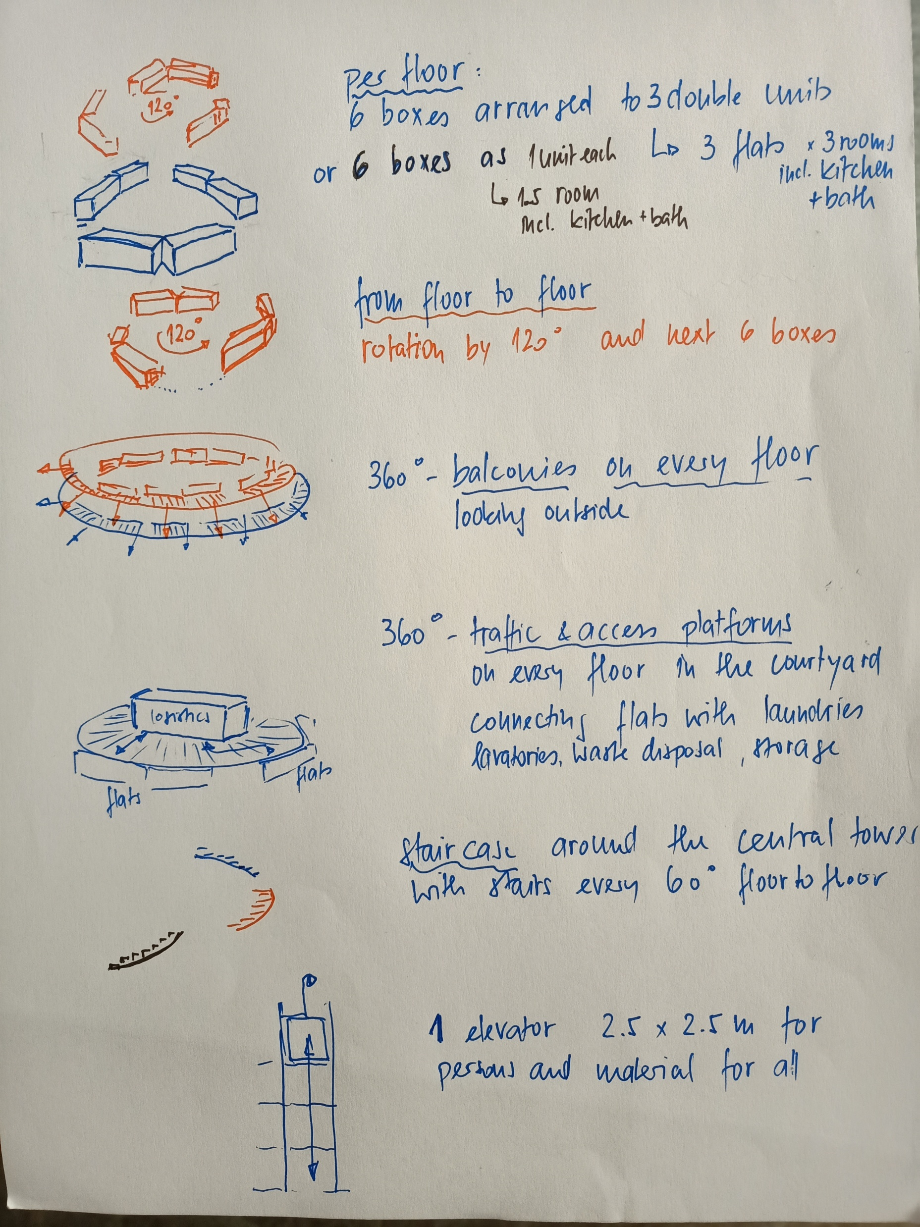
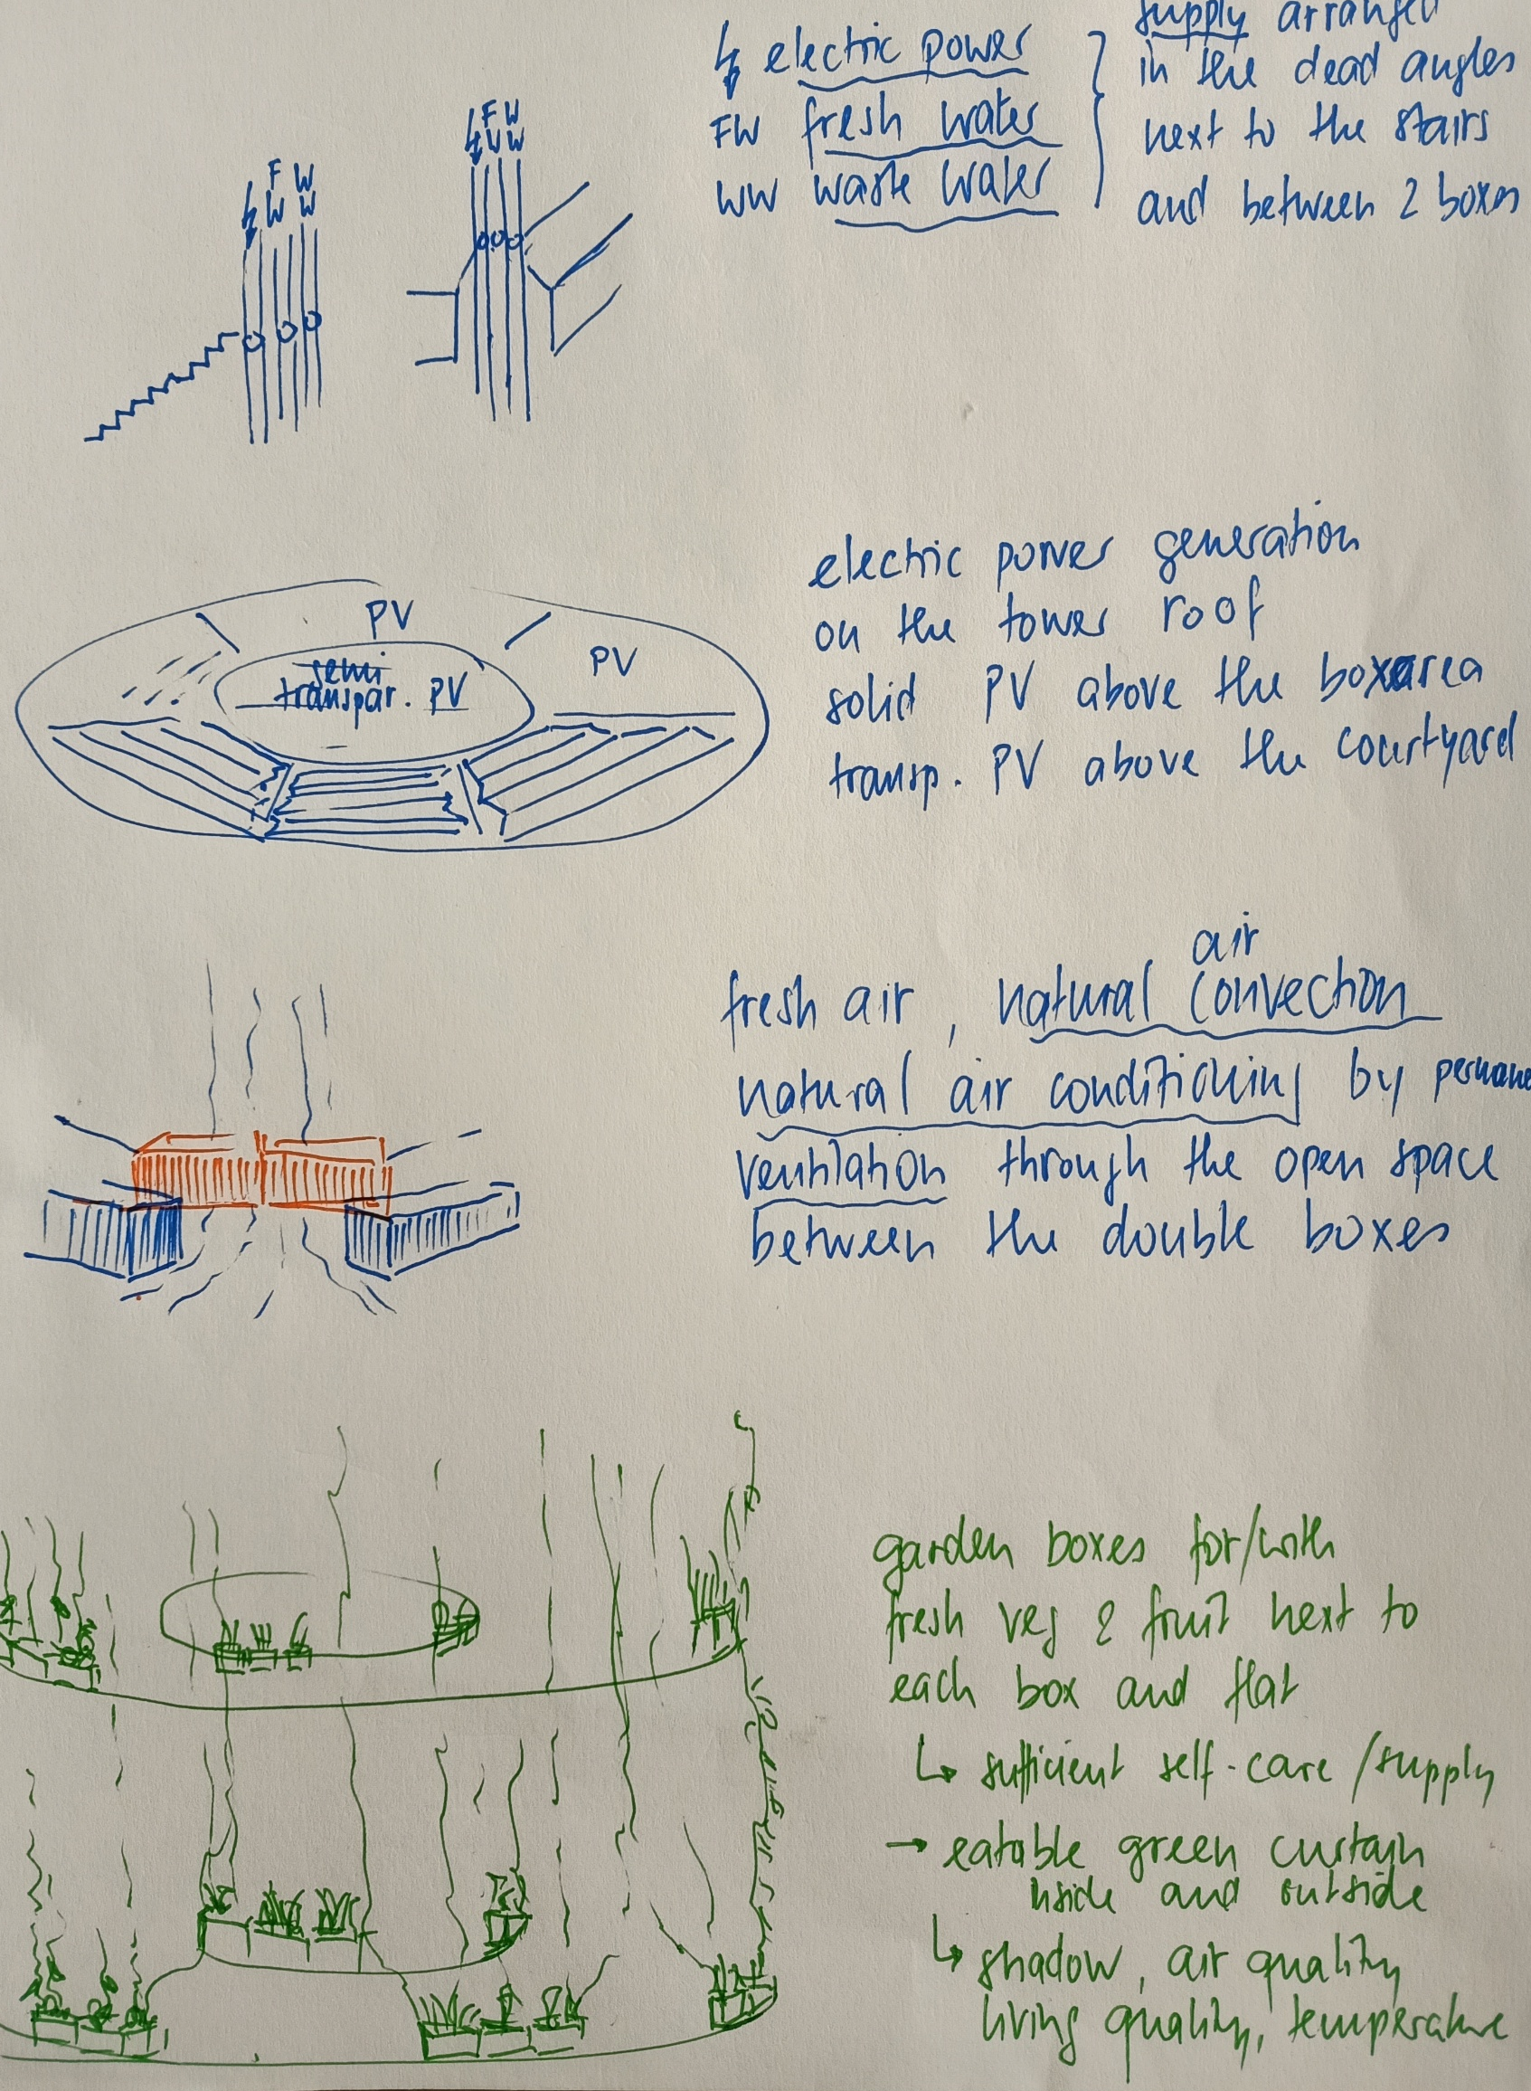
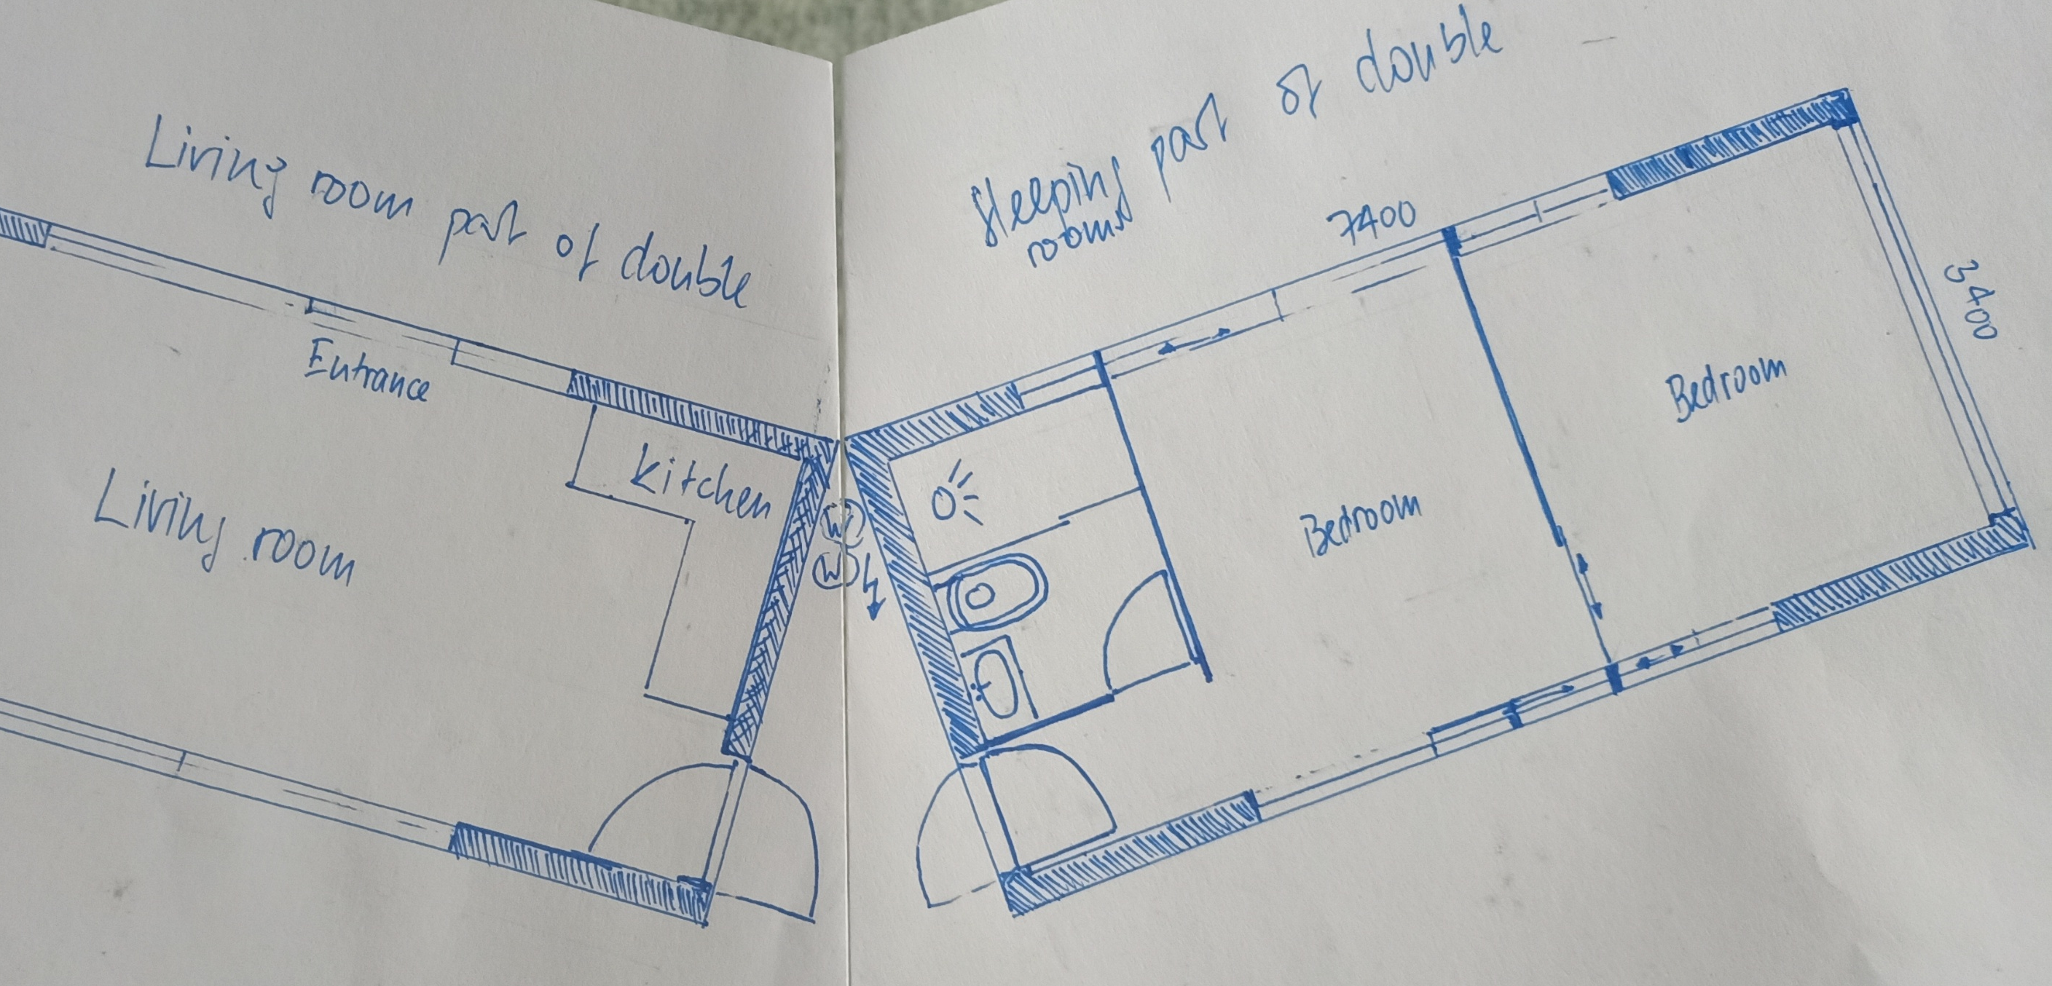

Slide 5
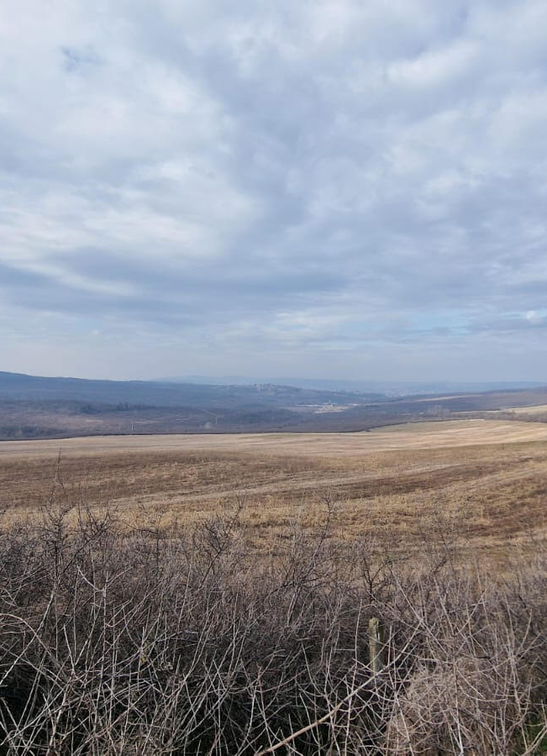
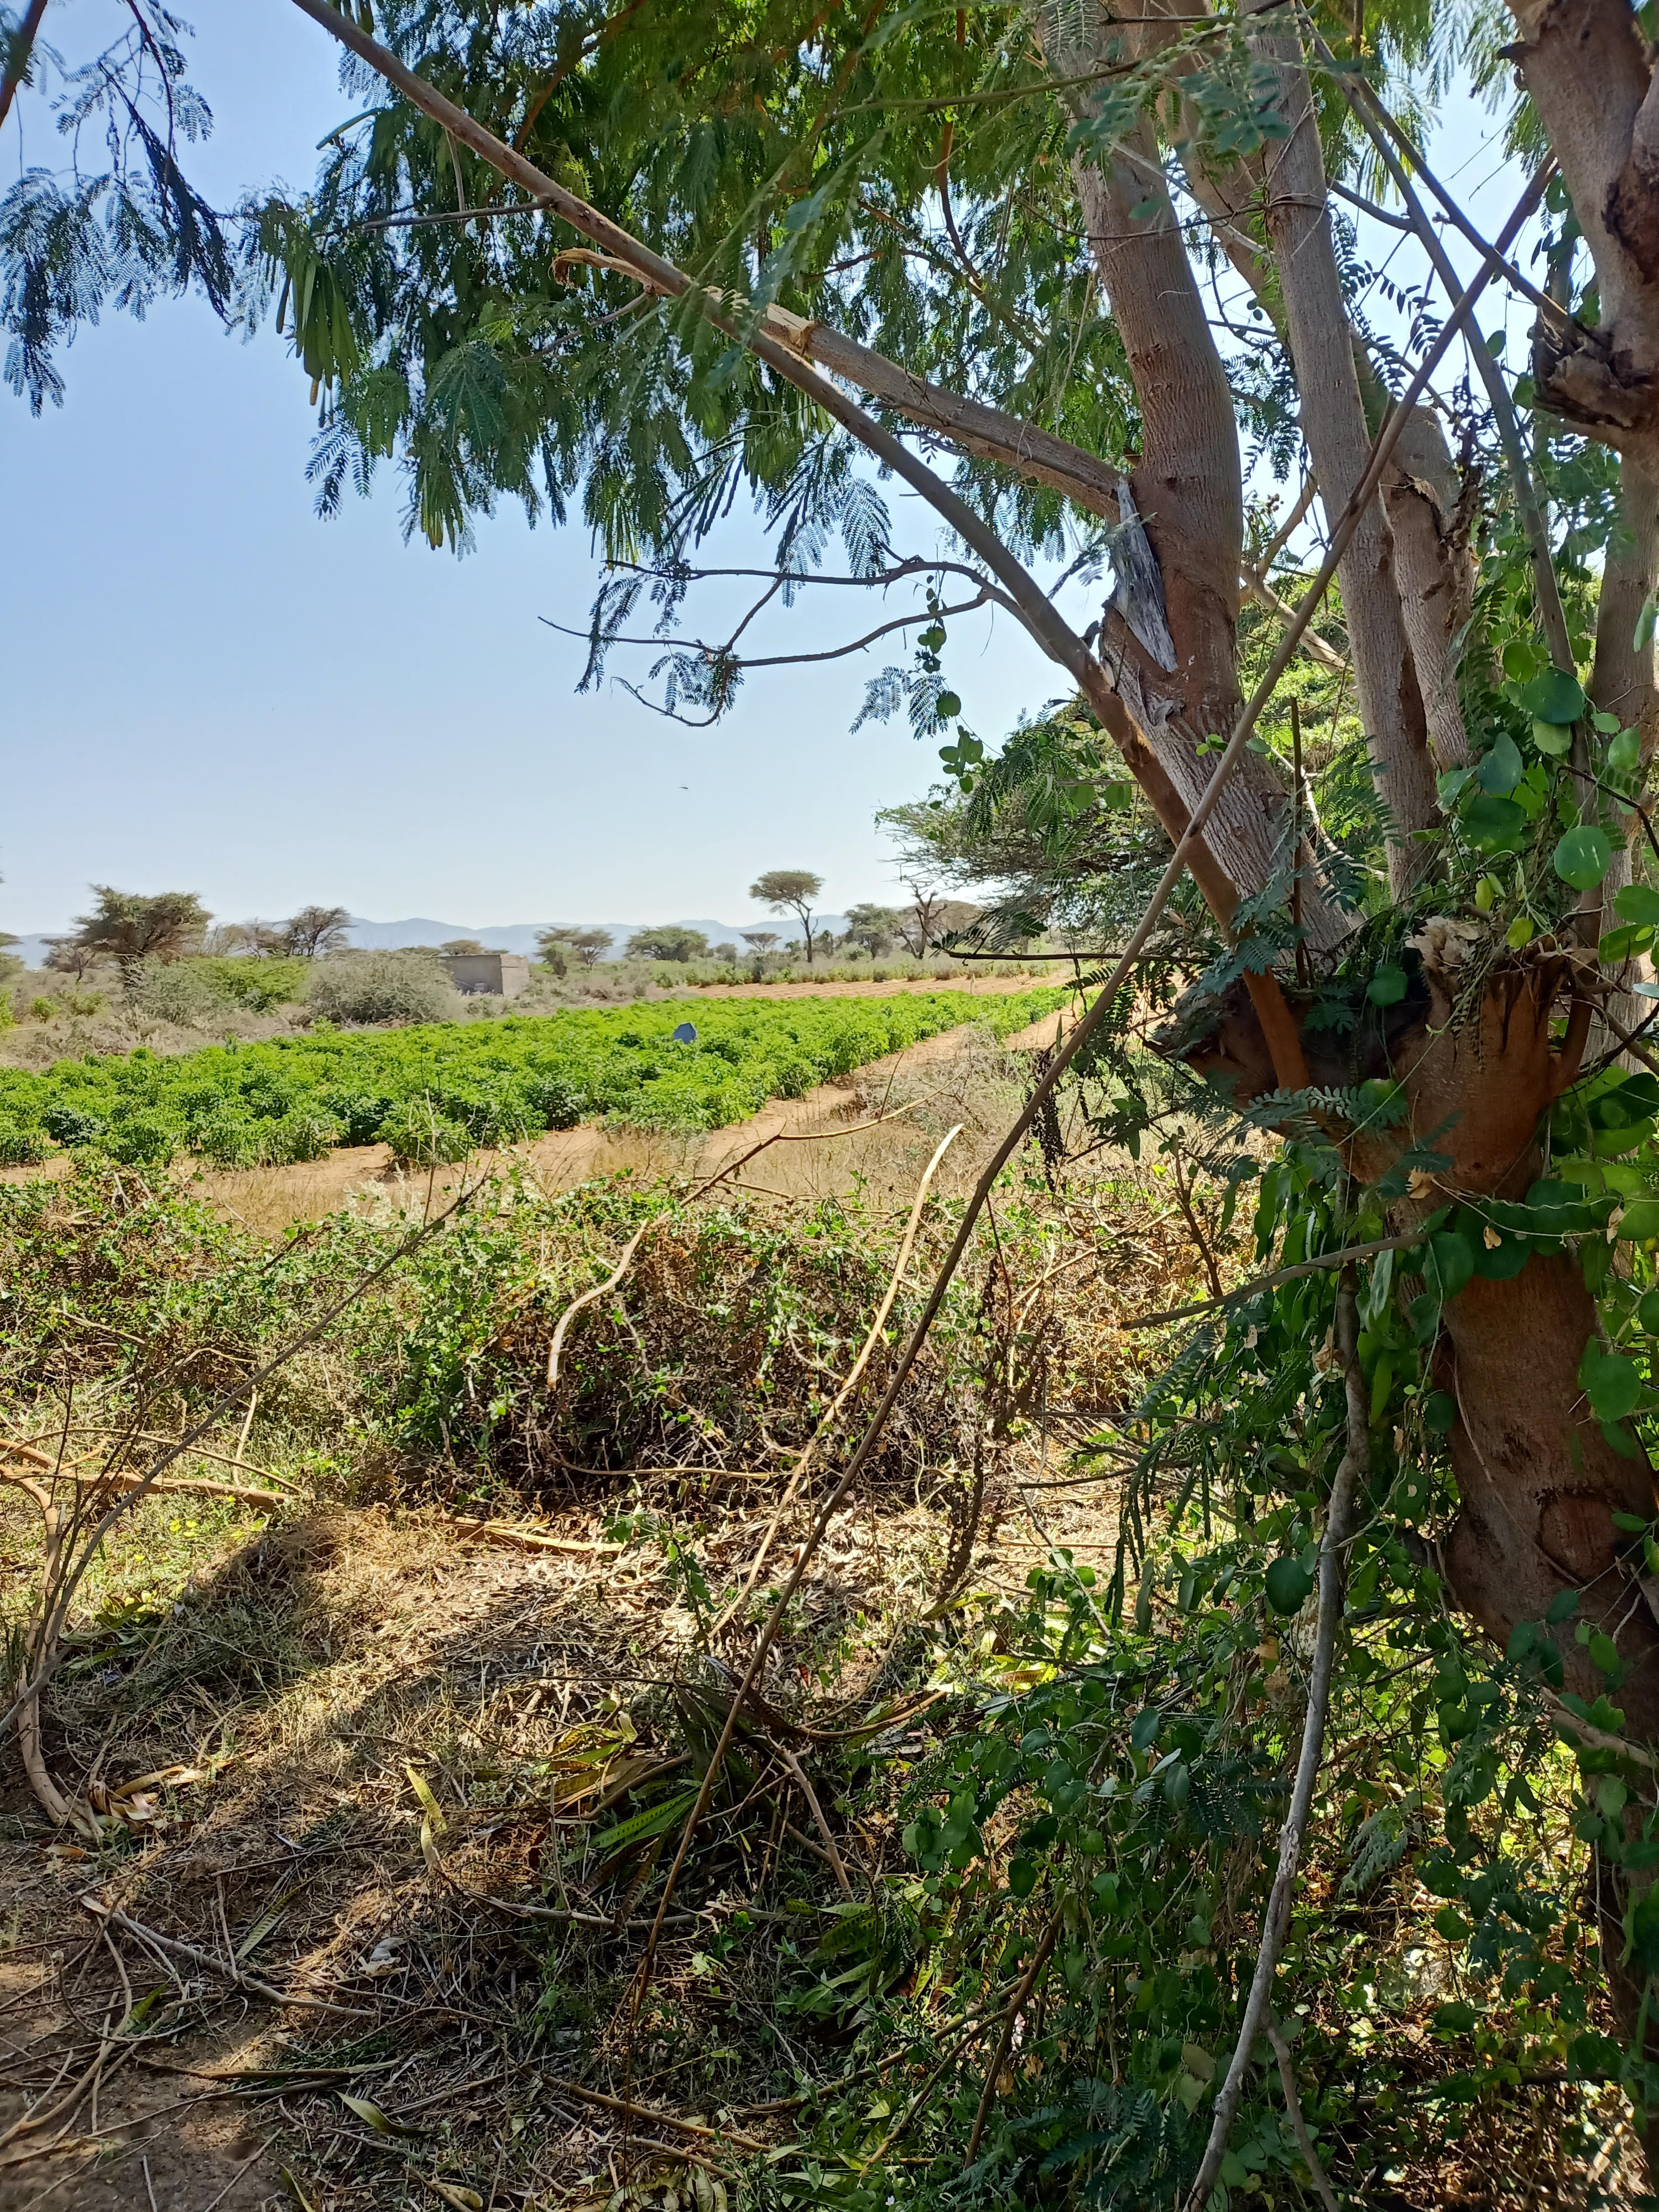
New business
for regions in
economic need
Sourcing the necessary raw materials for the first lot from
1000 ha in Somalia, Kenya
900 ha in Serbia
Empowering regional farming as provider of renewable materials, namely industrial hemp as heavily upcoming renewable resource for existing markets in the world.
First success creates exponential growth.

Slide 6
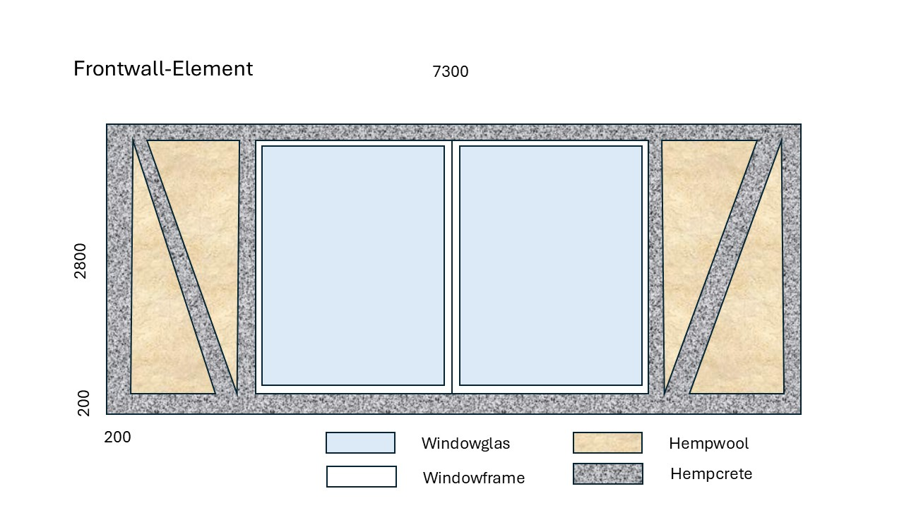
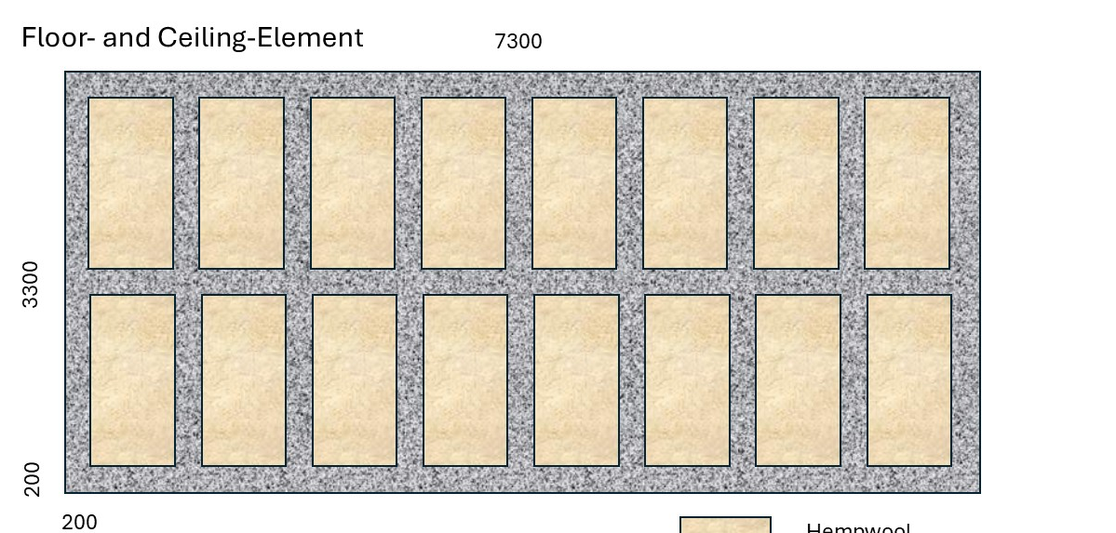
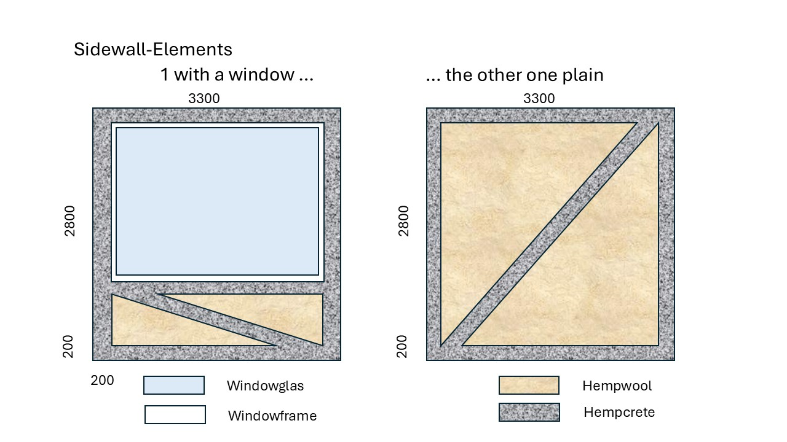
Prefabricated building elements
make high values and good services
Work places and good, valuable, longterm income
in the providing regions (East Africa, Serbia)
In time availability of good housing in the receiving
regions (Gaza, Syria, Ukraine, Los Angeles)

Slide 7

Useful, Fair,
and Safe
Investments
Customers and debitors are states and international organisations
Production is clean and fair
Products are safe and healthy
Empowerment relevant for nations, regions. and communities
Exponential growth after first success
Fast development brings fast return

Slide 8
Investors to finance 6 months of production which leads to delivery and incasso from states and international organisations

Slide 9
Potential
Exponential
growth due to
large resources
of farmland
big need of housing
and civilisation
triggers next 4
implementations
triggers next 2
implementations
Success of this current case …
semester 1
semester 2
semester 3
further continuation

Slide 10
Organisation
Simsal Group AG, Zurich, Switzerland
Group head office
Product & service development
Marketing & communications
Investor relations
Reporting, quality assurance
7 regionally anchored companies
in charge of the regional operations & relations
Simsal Switzerland AG
Simsal East Africa Ltd., Nairobi, Kenya
Simsal Europe GmbH, Beograd, Serbia
Simsal Latin America Ltd., Medellin, Columbia
Simsal USA & Canada Ltd.
Simsal Middle East Ltd., Muskat, Oman
Simsal Asia Ltd.
www.simsal.net
www.focushumanity.net

Slide 11
Management Team
Martin Klöti, dipl.Kult.Ing. ETH/BWI, Switzerland
resource and process engineer, developer
Head of Simsal Group AG
+41 79 405 69 33
Vladimir Visnjic, Beograd, Serbia
BC Baumann Construction Solutions, Beograd
Head of Simsal Europe GmbH
+ 63 7867843
Marcel Spicak, Dipl Arch SKA
Matthias Stähli, Dipl. Arch. ETH FSAI SIA
STÄHLI AG ARCHITEKTEN SIA, Lachen, Switzerland
Sustainable Architecture and Construction Design
Paul Stolle, Matten bei Interlaken, Switzerland
Studio Stolle
Branding & communications for sustainability
Abdi Naser Osman, Somalia and Hamburg
Head of Simsal East Africa Ltd.
+49 172 5856670
Mahdy Malik, Somaliland and London
Relation Manager, entrepreneur
+44 7950 571989

Slide 12
The Simsal Mission
Social enterprise to make humanity become a sound reality
Instigate lucrative economic activities of third parties and for its own
in harmony with and preserving the natural, ecological foundations of life
with a strong social impact for just and peaceful coexistence
consistently sustainable, fair and nature-oriented positioning of economy and society.
Simsal relies on
appreciation of the regions released from the globalized economy
regional strengthening towards regional autonomy and independence
humanism of a bionic, nature-oriented nature.
controllable, safe, practical low-tech technology in commercial and industrial processes.
natural principles with little material effort
solidary yield distribution with rapid break-even and good stability

